Slide 1

2023 PROVINCE COUNCIL UPDATES
Michael J. Dubose
President | Kappa Alpha Psi Foundation
Notes:
Have this up during the intro.

Slide 2
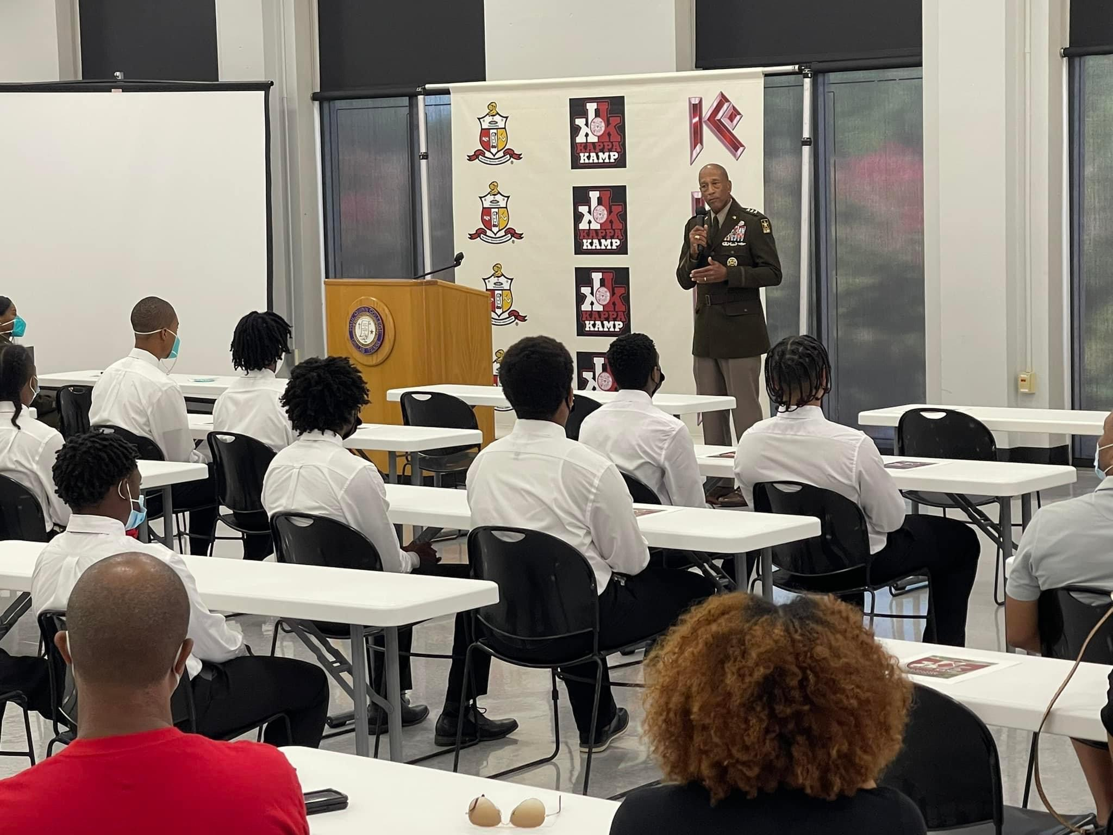
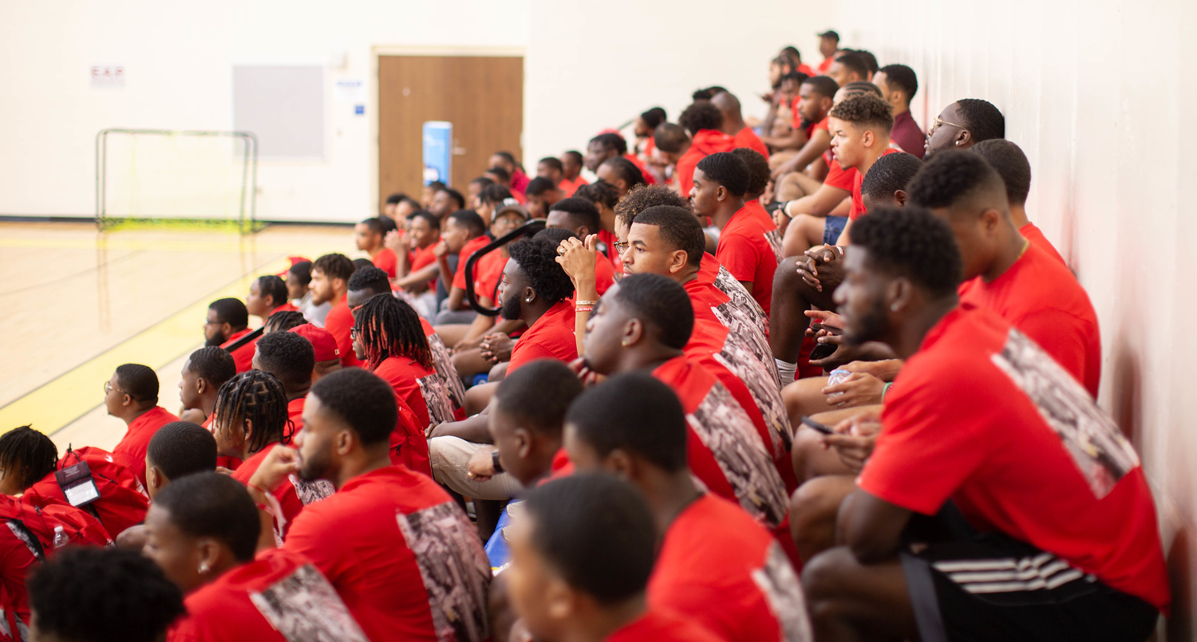

2022: THE POWER OF THE BOND
FUELS A NEW WAY FORWARD
Kappa Kamp returned to an in-person event at Paul Quinn University.
Undergraduate Leadership Institute (ULI) also returned
as an in-person activity for 89 undergraduates representing
78 colleges & universities.
The second virtual Celebration of Achievement provided more
than $100,000 in scholarships to high school and college students.

Slide 3
2022 DISBURSEMENTS
Naviance
Kappa Kamp/Kamp Kappa
Community Grants
Kellogg Grant/Guide Right
Kenan Grant/Guide Right
HH Holloway Scholarships
Partee Scholarship
COA Scholarships
$ 10,000
$ 2,500
$ 1,500
$ 1,000
$ 30,000
$ 20,000
$ 36,400
$ 25,000
$ 23,700
$ 35,000
$ 34,000
$ 113,700
$ 11,200
$ 24,000
$ 5,000
$ 10,000
TOTAL $ 383,000
M. Dubose Scholarships
R. Adkins Scholarship
S. Battle Scholarship
A. Ron Berryman Scholarship
Achievement Scholarships
STEM Scholarship Awards
SKAEF Grants
Undergraduate Leadership

Slide 4
THANK YOU FOR SUPPORTING THE FOUNDATION’S CAMPAIGNS
J5 KAPPATHON - $116,000
CELEBRATION OF ACHIEVEMENT - $206,000
CAPITAL CAMPAIGN - $989,000
Thank you for your support of the Kappa Alpha Psi Foundation.

Slide 5

CAPITAL CAMPAIGN
76 Legacy Program Participants
More than $105,000 raised through the
40 for 40 Anniversary campaign
11 new endowments generating more than
$2.5 million in committed funds for programs
and scholarships
Thank You!

Slide 6
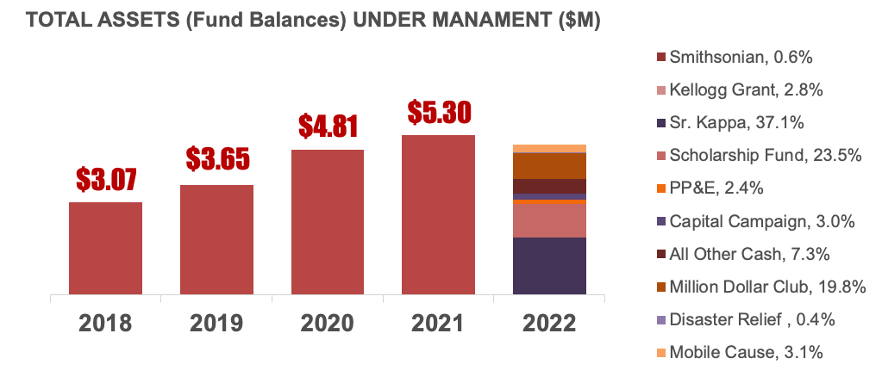

2022 FINANCIALS:
2022 Actuals
Actuals
Vs. Plan
Var - Fav/(Unfav)
Asset Management (Fund Balances)
Capital Campaign
  Fraternity Contributions¹
  Scholarships
  Corporate Sponsors
  Foundation & Grants
  Celebration of Achievement
Other Revenues
Total Revenues and Contributions
Functional/Management Exp
Rev over Exp. Before Disbursements
  Disbursements
Excess Rev over Expenses
$ 989
$ 346
$ 225
$ 35
$ 177
$ 206
$ 104
$1,093
$ 416
$ 677
$ 383
$ 294
$ 1,663
$ 871
$ 60
$ 300
$ 150
$ 281
$ 154
$1,816
$ 398
$1416
$ 398
$1,018
($ 675)
($ 50)
($723)
($ 18)
($ 739)
$ 15
($ 724)
$4.97
External Audit Status Updates
Audit Period | Planned | Status
FY 2018 | Completed - Unqualified
CY 2019 | Completed – Unqualified
CY 2020 | Completed – Unqualified
CY 2021 | Completed - Unqualified
  ¹includes: Foundation Club, K-100, Million Dollar Club, Silhouette Contributions

Slide 7
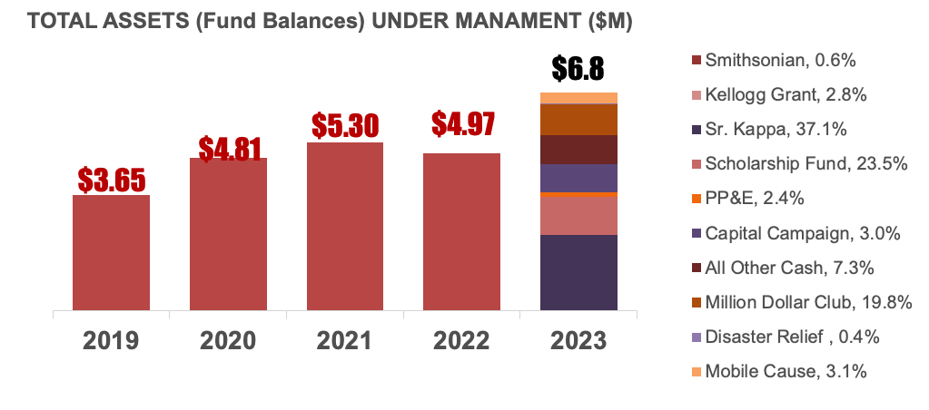
2023 BUDGETED FINANCIALS:
2023 Budget
Plan
Vs.PY
Var - Fav/(Unfav)
Asset Management (Fund Balances)
Capital Campaign
  Fraternity Contributions¹
  Scholarships
  Corporate Sponsors
  Foundation & Grants
  Planned Giving
  Celebration of Achievement
Other Revenues²
Total Revenues and Contributions
Functional/Management Exp
Rev over Exp. Before Disbursements
  Disbursements
Excess Rev over Expenses
$1,674
$ 498
$ 61
$ 350
$ 186
$ 265
$ 316
$ 90
$1,764
$ 617
$1,147
$ 264
$ 883
$ 989
$ 346
$ 225
$ 35
$ 177
$ 206
$ 104
$1,093
$ 416
$ 677
$ 383
$ 294
$ 685
($ 14)
$ 671
($ 201)
($ 470)
($ 119)
$ 589
Tough investment headwinds in 2022 – anticipating some recovery in 2023
  ¹includes: Foundation Club, K-100, Million Dollar Club, Silhouette Contributions
  ²includes J5 Kappathon

Slide 8

2023 GOALS AND OBJECTIVES
Continue support to Kappa Alpha Psi’s signature youth programs and youth educational scholarships
Develop an awareness module about the Foundation for the MTA Process and C. Roger Wilson Leadership Conferences
Enhance the Foundation’s infrastructure to better support Donor Customer Service
Complete the Capital Campaign with the 2023 goal of
$1.6 million and a stretch goal of $2 million
Promote the Foundation’s new Planned Giving component
Successfully execute the 2023 Celebration of Achievement
at the Grand Chapter Meeting

Slide 9
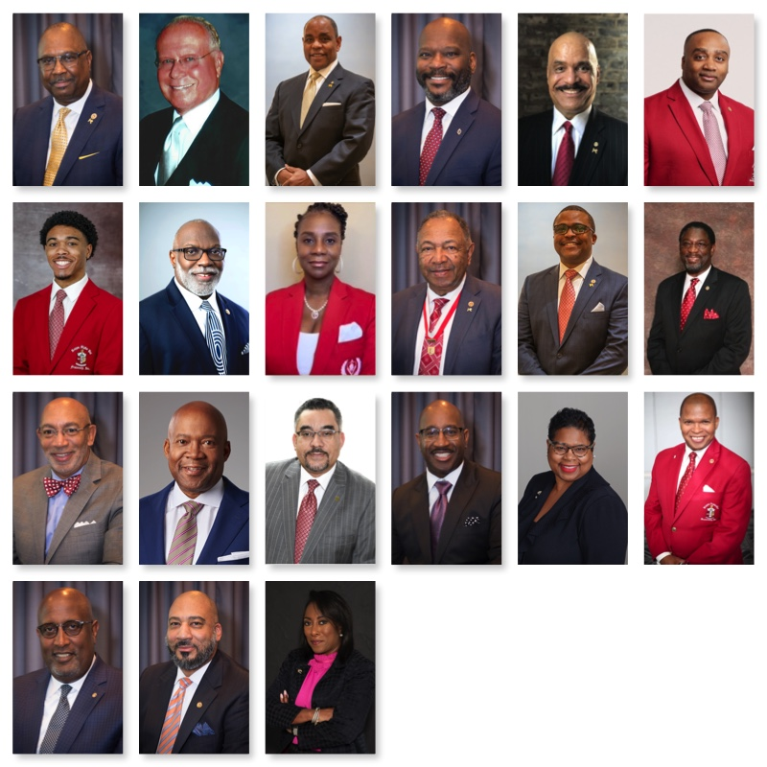
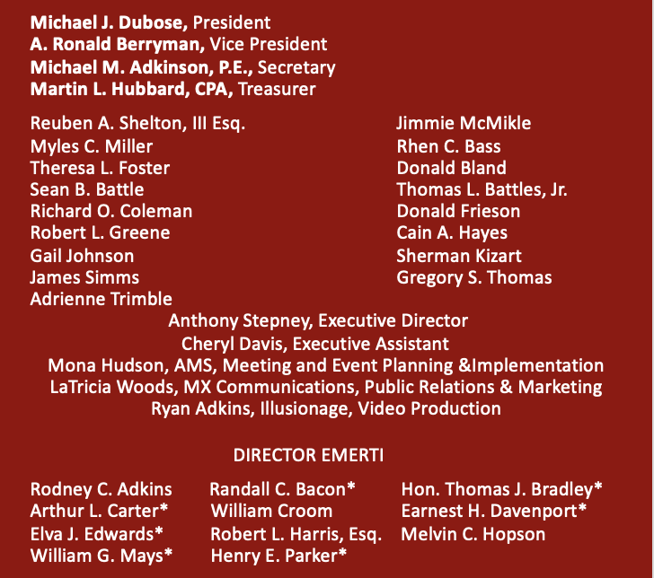
2022 BOARD OF DIRECTORS

Slide 10

COMING YOUR WAY IN 2023

Slide 11


Slide 12
The power of our fraternal bond continues to fuel the important work of the Kappa Alpha Psi Foundation.
We sincerely thank you for your support!
www.thekappafoundation.org

Slide 13
HILIARY H. HOLLOWAY PROVINCE SCHOLARSHIPS
Province Polemarchs – Please add the photo and name of your Holloway scholarship recipient(s).

